Slide 1
Machine Learning Analytics Pod Workstream 1 – Model Automation Training
Mar 2017

Slide 2
Agenda
Background
Model self-learning automation workflow
Hadoop schema functions
OpenSAE production codes training (Execute following programs in order)
Step 1 Model dataset preparation
Step 2 Feature selection steps
Step 3 Model performance criteria comparison
Step 4 Decision for choosing model for scoring
Step 5 Scoring on eligible members / accounts
Questions

Slide 3
Background
Traditional strategy
Models updated manually
Members / Clients scored using hard-coded method
Goal
Automate the whole process from model dataset building process to scoring production process
Increase model performance accuracy over time which in turn saves cost and increases revenue
What Pod workstream 1 model self-learning automation finished now
Automatically update logistic regression model coefficients
Automatically perform features selection using traditional logistic regession model selection method
Automatically monitor model performance over time for binary response
Automatically score eligible members / clients for logistic regression model

Slide 4
Model Self - Learning Automation Workflow
Score using base model (M00)
Looker dashboard
Base model – Initial Model developped
Hadoop tables
Selected model from last iteration (Base model will be the first selected model)
Score using selected model from last iteration (M01)
Specify model performance measures and requirements
Compare M01 with M02 on holdout dataset
Generate model performance criteria table
Append model performance table with historical information
Build a modeling dataset
Perform feature selection on training dataset
Score modeling dataset using current model (M02)
New model performance criteria exceeds threshhold?
Prepare dataset for scoring
No
Yes
Fact aggregation
Score on eligible members / accounts using M01
Selected model (M01) from last iteration
is updated using
current model

Slide 5
Hadoop Schemas FOR OPENSAE tEAM
1
OpenSAE Schema: Location for any database from CCW/CCDR/IDS.
2
Scratch Schema: This is used for storing intermediate (temporary) datasets
3
Val Schema: This schema will be used only for the purposes of validation. All tables related to validation for the model will reside here
Static Schema: This is the location where all static tables that are not part of the any database will reside. It will also be used to store final modeling dataset and parameter tables.
4
Share Schema: This schema will be used house fact outputs should there be a reason it cannot be shared with CCW/CCDR. It will also be used for sharing model comparison tables.
5
Highly recmended to develop models using IBOR

Slide 6
Hadoop Schemas FOR ANALYSTS
1
CIMA Schema: Location for any database from CCW/CCDR/IDS.
2
CIMA_Scratch Schema: This is used for storing intermediate (temporary) datasets.
3
Val Schema: This schema will be used only for the purposes of validation. All tables related to validation for the model will reside here..
Static Schema: This is the location where all static tables that are not part of the any database will reside. It will also be used to store final modeling dataset, parameter tables and modeling comparison tables.
4
Share Schema: This schema will be used house fact outputs should there be a reason it cannot be shared with CCW/CCDR. It will also be used for sharing model comparison tables.
5
Highly recmended to develop models using IBOR

Slide 7
Step 1 - Modeling Dataset Preparation Instruction
Input Variables
Consider all possible variable candidates as you are doing now
Remove all redundant steps
- If you used variable clustering to exclude redundant variables from final feature selection process, you don’t need to prepare those variables for production.
Group / transform / Impute input variables as usual before automatic feature selection step
Optimize codes by following standard in-database processing and minimize data step procedures
Prepare data by following in-database and parallel processing
Use CIMA and CIMA_SCRATCH hadoop tables
- Analysts should use CCW data as possible but are allowed to use any available data sources
- Analysts need to submit a request for moving tables from other sources to CIMA / OpenSAE schema
Create macro variables for job queue, schemas to make them robust
- For production, all schema names need to be converted to OpenSAE related schemas
Outcome (Response)
Prepare the outcome as you are doing now
Optimize codes by following standard in-database and parallel processing
Split variable
Prepare split variable for training and holdout dataset (and validation dataset) as you are doing now

Slide 8
Step 1 - Modeling Dataset Preparation Instruction
Timing (Key to make automation work)
Identify all timing related information
Hard-code timing related information as usual to make sure all codes work
Transfer all hard-coded timing related information to macro variables using today’s date information
Dataset name format
Please use model id as prefix for all of your dataset names
Make sure that dataset name length <= 32
Final output:
Final modeling dataset name should have prefix which is model id (ex: CGNMDL0826_...)
OpenSAE team will submit a request to Code Runner ID Tracking team. Once model id is ready you should name final modeing data with prefix being yourmodelid_
The length of modeling dataset name should be less than or equal to 23
Automatically updated based on run date
Only keep final modeling dataset and drop all intermediate datasets

Slide 9
Step 1 - Modeling Dataset Preparation: Codes Examples
How to enable parallel processing and create macro variables related to schemas
option SASTRACE = ",,,d" sastraceloc=saslog MACROGEN symbolgen ;
options dsaccel=any; /*DSACCEL=any enables the DATA step to execute in supported parallel environments*/
options ds2accel=any; /*DS2ACCEL=any enables the DATA step to execute in-database*/
options msglevel=i; /*MSGLEVEL=I enables the user to see which options prevent or affect in-database processing*/
/*these are for encouraging in-db processing*/
options DBIDIRECTEXEC SQLGENERATION=DBMS;/* Avoids downloads when creating tables via IP; not a default setting */
options SQL_IP_TRACE=SOURCE; /*SQL_IP_TRACE=SOURCE - Shows SQL push down*/
options SPDEPARALLELREAD=yes FULLSTIMER SPOOL;
%let dsn_scm=OPENSAE; /*Hadoop schema name for all input datasets*/
%let job_q=%str(sas.g_hadoop_p_cima); /*Job queue name*/
%let scrh_scm=CIMA_SCRATCH; /*Hadoop schema name for all intermediate datasets*/
%let scrh_lib=CM_SCRH; /*Hadoop schema libname for all intermediate datasets*/
libname &scrh_lib. hadoop PORT=25006 server='hive.sys.cigna.com' subprotocol=hive2 HDFS_TEMPDIR='hdfs://nameservice1/saseg' schema=&scrh_scm. DBMAX_TEXT=30 dbconinit="set hive.exec.parallel=true" properties="mapred.job.queue.name=&job_q.";
%let md_job_q=%str(sas.g_hadoop_p_sas_developers); /*Job queue name*/
%let md_scm=OPENSAE_STATIC; /*Hadoop schema name for storing final modeling dataset*/
%let md_lib=SAE_STC; /*Hadoop schema libname for final modeling dataset*/
libname &md_lib. hadoop PORT=25006 server='hive.sys.cigna.com' subprotocol=hive2 HDFS_TEMPDIR='hdfs://nameservice1/saseg' schema=&md_scm. DBMAX_TEXT=30 dbconinit="set hive.exec.parallel=true" properties="mapred.job.queue.name=&md_job_q.";
Add this part at the top of each sas code

Slide 10
Step 1 - Modeling Dataset Preparation: Codes Examples
How to drop intermediate tables
Example:
PROC SQL NOERRORSTOP;
CONNECT TO HADOOP (SERVER='hive.sys.cigna.com' PORT=25006);
EXECUTE (set mapred.job.queue.name=&job_q.) by hadoop;
EXECUTE (DROP TABLE &scrh_scm..test) by hadoop;
Quit;

Slide 11
Step 1 - Modeling Dataset Preparation: Timing Examples
How to create timing related macro variables using today’s date
Example 1: Get past 12 months FACT Job ID information between model run date '2016-03-01‘ and '2017-02-28‘
DATA _NULL_;
%LET RUN_DATE = TODAY(); /*Assume today’s date is in Mar*/
DATETIME_FACT_START = INTNX('MONTH',&RUN_DATE.,-12,'BEG');
DATETIME_FACT_END = INTNX('MONTH',&RUN_DATE.,-1,'END');
DATETIME_FACT_START_P = COMPRESS("'"||(PUT(DATETIME_FACT_START,YYMMDD10.))||"'",);
DATETIME_FACT_END_P = COMPRESS("'"||(PUT(DATETIME_FACT_END,YYMMDD10.))||"'",);
PUT 'DATE FACT START IS ' DATETIME_FACT_START_P;
PUT 'DATE FACT END IS ' DATETIME_FACT_END_P;
CALL SYMPUT('FACT_STRT', DATETIME_FACT_START_P);
CALL SYMPUT('FACT_END' , DATETIME_FACT_END_P);
RUN;
PROC SQL NOERRORSTOP;
CONNECT TO HADOOP (SERVER='hive.sys.cigna.com' PORT=25006);
EXECUTE (set mapred.job.queue.name=sas.g_hadoop_p_sas_developers) by hadoop;
EXECUTE (DROP TABLE CIMA_SCRATCH.TEST) by hadoop;
EXECUTE (CREATE TABLE CIMA_SCRATCH.TEST AS
Select A.RUN_DT, A.JOB_EXECN_ID AS FACT_JOB_ID, C.STAT_DESC
From OPENSAE.SAE_MDR_JOB A, OPENSAE.CCDM_MSTR_DT_DIM B, OPENSAE.SAE_MDR_STAT C
WHERE TO_DATE(A.RUN_DT) BETWEEN &FACT_STRT AND &FACT_END AND A.RUN_DT=B.CAL_DT AND
A.WRITE_TIMESTMP IS NOT NULL AND A.STAT_ID = C.STAT_ID AND C.STAT_DESC <> 'Abandoned'
)BY HADOOP;
disconnect from hadoop;
Quit;

Slide 12
Step 1 - Modeling Dataset Preparation: Timing Examples
How to create timing related macro variables using today’s date
Example 2: Create a macro variable named as DATETIME_MEDELG_END_P which will be resolved to the value of last month '201702‘.
DATA _NULL_;
%LET RUN_DATE = TODAY(); /*Assume today’s date is in Mar*/
DATETIME_MEDELG_END = INTNX('MONTH',&RUN_DATE.,-1,'END');
DATETIME_MEDELG_END_P = COMPRESS("'"||(PUT(DATETIME_MEDELG_END,YYMMN6.))||"'",);
PUT 'DATE MEDICAL ELGB END IS ' DATETIME_MEDELG_END_P;
CALL SYMPUT('MED_END', DATETIME_MEDELG_END_P);
RUN;

Slide 13
Step 2 – Feature Selection Step
Analyts feel free to use any algorithms for feature selection
You need to use training dataset by conditioning on modeling dataset for feature selection unless you just want to update coefficients using same predictors from base model
Input dataset required
Modeling dataset
Base model which analysts built and business partners approved (In my example, I named as &DSN_ANA_MD)
Base model needs to be stored before starting the whole automation process
- You will see an example later (Please note that you shouldn’t include this code in your final automation process codes)
Base model will be used for scoring on modeling dataset
Selected model from last interation (In my example, I named as &DSN_OLD_MD)
Before you starting the feature selection step, you need to copy base model and rename it
- In the first iteration, selected model will be the base model
&DSN_OLD_MD will be replaced if model performance criteria increases by predefined threshold (We will talk about in step 4)

Slide 14
Step 2 – Feature Selection Step
Location for an example using traditional logistic regression model
http://git.sys.cigna.com/ML-Analytics-Pod/Workstream1/blob/develop/Automation_Feature_Selection_Training_Example.sas
Final output required
The output dataset is a scoring dataset for modeling dataset
The output dataset name should be yourmodelingdatasetname_SCRG_NEW
The output dataset should have the following variables
Response variable
Split variable which split data into training, holdout dataset and else if you want to)
Prediction using initial finialized model (base model) – please name it as ANA_MD_SCRG
Prediction using new model from feature selection step – please name it as NEW_MD_SCRG
Prediction using selected model from last iteration – please name it as OLD_MD_SCRG
Drop all intermediate datasets except models used for scoring and final scoring dataset

Slide 15
Step 2 – Feature Selection Step: Base Model Example
Example to generate base model using proc logistic for binary response
libname SAE_STC hadoop PORT=25006 server='hive.sys.cigna.com' subprotocol=hive2 HDFS_TEMPDIR='hdfs://nameservice1/saseg' schema=OPENSAE_STATIC
DBMAX_TEXT=30 dbconinit="set hive.exec.parallel=true" properties='mapred.job.queue.name=sas.g_hadoop_d_sas_developers';
libname CM_SCRH hadoop PORT=25006 server='hive.sys.cigna.com'
subprotocol=hive2 HDFS_TEMPDIR='hdfs://nameservice1/saseg' schema=CIMA_SCRATCH
DBMAX_TEXT=30 dbconinit="set hive.exec.parallel=true" properties='mapred.job.queue.name=sas.g_hadoop_d_sas_developers';
PROC SQL NOERRORSTOP;
CONNECT TO HADOOP (SERVER='hive.sys.cigna.com' PORT=25006 );
EXECUTE (set mapred.job.queue.name=root.g_hadoop_p_cima) by hadoop;
EXECUTE (DROP TABLE CIMA_SCRATCH.C71318_MD_TRAIN) by hadoop;
QUIT;
RUN;
PROC LOGISTIC DATA=SAE_STC.C71318_WK1_TRN_MD (WHERE=(SUM_ATTEMPTS <3)) OUTMODEL=CM_SCRH.C71318_MD_TRAIN;
CLASS FACT_ID/ PARAM = REF;
MODEL TEL_ENG_SUCCESS (EVENT="1") = AGE IND_HRA RISK_SCORE_NUM_PRE SUM_ATTEMPTS FACT_ID/SELECTION=STEPWISE LACKFIT;
RUN;

Slide 16
Step 3 – Model Performance Criteria Comparison
Input dataset
Scored modeling dataset from feature selection step
Output dataset required
Model performance criteria comparison result table
Please also share it in a schema which business partner can see or use if you develop your own program
Model performance criteria comparison result table for model (You can see an example in page 18)
date (Run date)
stat (Statistic name used for comparing new model with selected model from last iteration)
EX: Logistic regression :AUC, KS, GINI
old_model (Statistic result from selected model from last interation)
new_model (Statistic result from new model based on new coming data)
incrs_perc (Percentage of new model performance criteria increase)
Incr_avg (This is not necessary if you only have one criteria for checking model performance)
- For model with binary response, I used average of KS, GINI and AUC to make decision
new_adopt_ind (An indicator with 1 if exceeding specified threshhold - new model needs to be selected, 0 otherwise)
You need to set up threshhold value for incrs_perc (incr_avg). In my example, if incr_avg is >= 2%, then new_adopt_ind will be 1
ttl_count (Total records of modeling dataset)
If you want to develop your own program
You should specify performance requirements which are used for updating model and append all historical comparison results together

Slide 17
Step 3 – Model Performance Criteria Comparison Macro
Location for a SAS macro to compare new model and selected model from last iteration for models with binary response and an example for recalling that macro
You need to have scored modeling dataset from step 2 available for using this macro
http://git.sys.cigna.com/ML-Analytics-Pod/Workstream1/blob/develop/Automation_Step3_Model_Comparison_Training.sas

Slide 18
Step 3 - Model Performance Comparison Criteria Trend Example
date | stat | old_model | new_model | incrs_perc | incr_avg | new_adopt_ind | count
15Nov2016 | AUC | 0.7443 | 0.7514 | 0.95% | 1.83% | 0 | 146024
15Nov2016 | GINI | 0.4887 | 0.5028 | 2.89% | 1.83% | 0 | 146024
15Nov2016 | KS | 0.3897 | 0.3961 | 1.64% | 1.83% | 0 | 146024
15Dec2016 | AUC | 0.7437 | 0.7468 | 0.42% | 1.04% | 0 | 147227
15Dec2016 | GINI | 0.4875 | 0.4935 | 1.23% | 1.04% | 0 | 147227
15Dec2016 | KS | 0.3842 | 0.3898 | 1.46% | 1.04% | 0 | 147227
15Jan2017 | AUC | 0.75 | 0.7571 | 0.95% | 2.05% | 1 | 164138
15Jan2017 | GINI | 0.5 | 0.5141 | 2.82% | 2.05% | 1 | 164138
15Jan2017 | KS | 0.3884 | 0.3977 | 2.39% | 2.05% | 1 | 164138
Now the new model will replace the original model for scoring b/c the average statistic increased by more than 2% (threshhold)

Slide 19
Step 4 – How to Choose a Model for Scoring
Input dataset
Model performance criteria comparison table for step 3
Design instruction
Selected model needs to be replaced by new model if model performance criteria increases by your specified threshhold
The reason is that step 5 scoring process will use selected model for scoring on eligible members
Location for an example for updating selected model for scoring in step 5
http://git.sys.cigna.com/ML-Analytics-Pod/Workstream1/blob/develop/Automation_Step4_Model_Update_Decision_Ex.sas

Slide 20
Step 5 – Score Eligible Members / Accounts
Data preparation Instruction
Prepare data for eligible members / accounts for scoring
Data preparation needs to follow requirements and instruction from step 1 modeling dataset preparation except that you don’t need to prepare response variable (outcome) and splitting variable
Please use model id + _prd_ as prefix for all of your dataset names (i.e.: dataset name format: modelid_prd_...)
Prepare timing related macro variables to replace hard-coded dates
Score eligible members / accounts using selected model from step 4
Adjust your prediction from above step if necessary (?)

Slide 21
Step 5 – Score Eligible Members / Accounts
An example for scoring on prepared dataset
PROC SQL NOERRORSTOP;
CONNECT TO HADOOP (SERVER='hive.sys.cigna.com' PORT=25006);
EXECUTE (set mapred.job.queue.name=root.g_hadoop_p_sas_developers) BY HADOOP;
EXECUTE (DROP TABLE CIMA_SCRATCH.C71318_WK1_TRN_ELGB_SCRG_OUT) BY HADOOP;
QUIT;
libname SAE_STC hadoop PORT=25006 server='hive.sys.cigna.com'
subprotocol=hive2 HDFS_TEMPDIR='hdfs://nameservice1/saseg' schema=OPENSAE_STATIC
DBMAX_TEXT=30 dbconinit="set hive.exec.parallel=true" properties='mapred.job.queue.name=sas.g_hadoop_d_sas_developers';
libname CM_SCRH hadoop PORT=25006 server='hive.sys.cigna.com'
subprotocol=hive2 HDFS_TEMPDIR='hdfs://nameservice1/saseg' schema=CIMA_SCRATCH
DBMAX_TEXT=30 dbconinit="set hive.exec.parallel=true" properties='mapred.job.queue.name=sas.g_hadoop_d_sas_developers';
%LET DSN_OLD_MD = C71318_WK1_TRN_PARM;
%LET LIB_OUT = SAE_STC;
PROC LOGISTIC INMODEL=&LIB_OUT..&DSN_OLD_MD. (TYPE = LOGISMOD) NOPRINT;
SCORE DATA = CM_SCRH.C71318_WK1_TRN_ELGB_SCRG OUT = CM_SCRH.C71318_WK1_TRN_ELGB_SCRG_OUT (RENAME=(P_1=PREDICTION));
RUN;

Slide 22

Questions
Confidential, unpublished property of Cigna. Do not duplicate or distribute. Use and distribution limited solely to authorized personnel. © 2015 Cigna
22

Slide 23
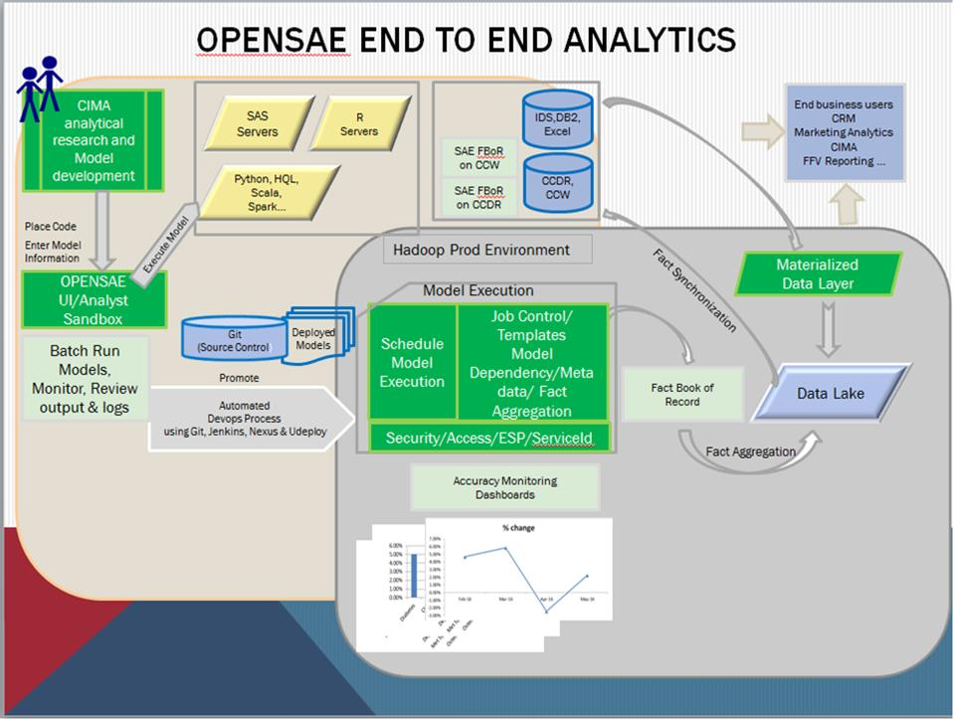

Slide 24
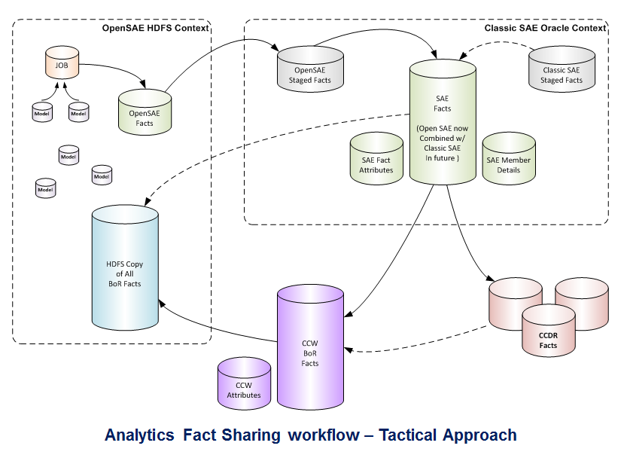

Slide 25
All Cigna products and services are provided exclusively by or through operating subsidiaries of Cigna Corporation, including Cigna Health and Life Insurance Company, Connecticut General Life Insurance Company, Cigna Behavioral Health, Inc., and HMO or service company subsidiaries of Cigna Health Corporation. The Cigna name, logo, and other Cigna marks are owned by Cigna Intellectual Property, Inc.
000000 00/15 © 2016 Cigna. Some content provided under license.

